Slide 1
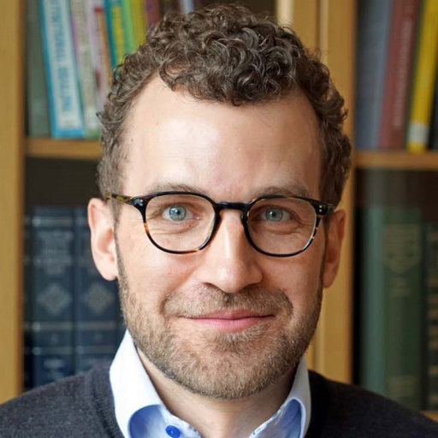
i
RECKLESSLY SPENDING OR CAREFULLY
NVESTING
YOUR LIFE?
TORBEN BERGLAND, M.D.

Slide 2
Back to Eden, moving forward stronger!

Slide 3
Everyday are opportunities for us to truly live.

Slide 4
We may die once, but every other day is a day to live.

Slide 5
When it comes to money, we fail reckless spenders.

Slide 6
What constitutes a carefully invested life as opposed to a life spent recklessly?

Slide 7
Short-term pleasures of reckless spending weigh little compared to long-term suffering.

Slide 8
Careful investment for your own benefit is much better.

Slide 9
Even so, people continue to be reckless spenders until they have nothing left to spend.

Slide 10
Are we recklessly spending our lives, or are we carefully investing day after day?

Slide 11
Do we lose out on life and lose life prematurely because we don't set the right priorities?

Slide 12
Unfortunately, the most frugal in money matters may still be reckless spenders of life, with more devastating results than ruined finances.

Slide 13
A ruined life, now or in the future, is a high price to pay for failing to properly invest in life.

Slide 14
Where should we invest faithfully to reap the greatest gains for ourselves and others?

Slide 15
See, I set before you today life and prosperity, death and destruction. For I command you today to love the Lord your God, to walk in obedience to him, and to keep his commands, decrees and laws; then you will live and increase, and the Lord your God will bless you. . . . Now choose life, so that you and your children may live and that you may love the Lord your God, listen to his voice, and hold fast to him. For the Lord is your life.
Deut. 30:15, 16, 19-20 (NIV)

Slide 16
Careful and faithful investment in life will always be in the Lord and through the Lord.

Slide 17
In Eden, God's intention was for life to be good.

Slide 18
Receiving

Slide 19
Life is receiving what God gives, and there is nothing to be desired but what He has given.

Slide 20
Unfortunately, since then humanity has struggled to take what it did not receive and trusts itself instead of depending on God.

Slide 21
Adam and Eve were given everything, except the fruit of “the tree of the knowledge of good and evil.”

Slide 22
Whenever man craves and claims something God has not given, evil and death are the outcome.

Slide 23
Our first principle of living abundantly is to appreciate, to be content with, and to be grateful for what God has given.

Slide 24
resting

Slide 25
Life for humankind began with rest.

Slide 26
Nothing can be added to what God has done. What He has done is sufficient and good.

Slide 27
since then humankind has violated the principle of restful living in body and spirit.

Slide 28
Humans need spiritual rest, the weekly rest, and the nightly rest. If these needs are not honored, they will recklessly spend their lives.

Slide 29
God gave us the Sabbath and the night.

Slide 30
Rest precedes work, both in the spiritual realm and the physical realm.

Slide 31
The second principle of living abundantly is to invest in restful living in the spirit and in the body.

Slide 32
Connectedness

Slide 33
It is not good that man should be alone; I will make him a helper comparable to him
Gen. 2:18, Nkjv

Slide 34
God lay down in the heart of man a desire for something more—the desire for companionship with someone who was his equal.

Slide 35
Unfortunately, since then humankind has tended to become either overly materialistic or overly religious to the neglect of their fellow humans.

Slide 36
As men and women cannot live fulfilled lives without the intimate loving relationship with the Creator above them nor the creation below them, neither can they live fulfilled lives without the intimate loving relationship with the creature beside them.

Slide 37
Therefore, our third principle of living abundantly is the harmonious connection with the Creator above us, the creatures beside us, and the creation below us.

Slide 38
Activity

Slide 39
At Creation, humans were appointed to be reflections of God as they ruled over the creation in the image of the Creator.

Slide 40
Though they could never add to God’s creation, they were “to tend and keep it”.

Slide 41
Through this activity they themselves would be blessed and stay healthy.

Slide 42
Unfortunately, since then humans have exploited and abused the creation rather than cared for it.

Slide 43
Through the estrangement from creation, from tending and keeping it, humankind itself is suffering.

Slide 44
Physical inactivity is a leading cause of lifestyle illnesses, and lack of purpose and meaning in work is prevalent.

Slide 45
Therefore, our fourth principle of living abundantly is activity in harmony with what we were created for.

Slide 46
Nourishment

Slide 47
As God gave Eden for men and women to live in, He also provided what they needed to live abundant lives.

Slide 48
Following Creation men and women were to live off the fruits of the trees in the Garden .

Slide 49
And the LORD God commanded the man, “You are free to eat from any tree in the garden.
Gen. 2:16 NIV

Slide 50
After the Fall, they would also eat food from the ground and plants of the field .

Slide 51
To Adam he said, “Because you listened to your wife and ate fruit from the tree about which I commanded you, ‘You must not eat from it,’
“Cursed is the ground because of you;
through painful toil you will eat food from it
all the days of your life.
Gen. 3:17, 18, nIv

Slide 52
Then, after the Flood, people were allowed to eat animals.

Slide 53
Everything that lives and moves about will be food for you. Just as I gave you the green plants, I now give you everything.
Gen. 9:3 nIv

Slide 54
Despite the permission to eat a variety of foods, however, we know that a balanced, whole-foods, plant-based diet with the supplementation of essential nutrients such as vitamin B₁₂ is the most healthful diet whenever and wherever it is available.

Slide 55
What God made and intended for our use cannot be improved upon.

Slide 56
Unfortunately, humankind has desired to eat what was not allowed or intended.

Slide 57
When we go contrary to what we were created for, what the animals were created for, and what nature was created for, then creation is subjected to pain and death.

Slide 58
We may still strive to nourish ourselves primarily on the foods God created us for.

Slide 59
Our fifth principle of living abundantly is to nourish ourselves on real foods, not artificial man-made substitutes of what God provides through nature.

Slide 60
When we allow God to be the center of our lives and receive what He has abundantly provided, then we may enjoy the richness and blessings of a carefully and faithfully invested life, and not recklessly spend what has not been given to us.

Slide 61
Careful and faithful investment in life will always be in the Lord and through the Lord.

Slide 62
i
GASTANDO SUA VIDA DE FORMA IMPRUDENTE OU
NVESTINDO
SUA VIDA CUIDADOSAMENTE?
TORBEN BERGLAND, M.D.

