Slide 1
T
ithing: A response to grace
BY William E. McCumber

Slide 2
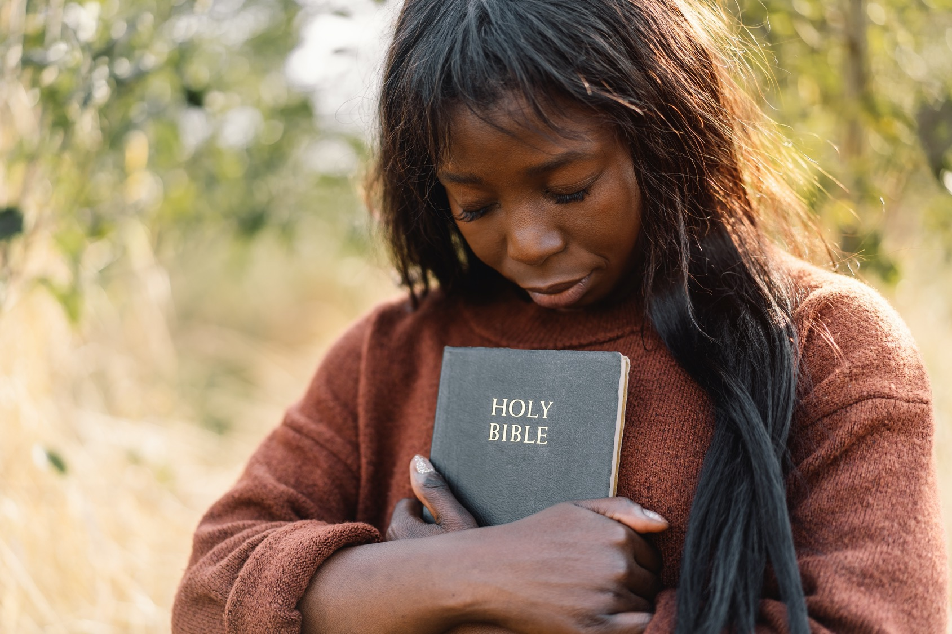
Summary: Some have argued that Christians need not tithe because they are under grace, not under law. No Christian should do less for God than did an ancient Jew.

Slide 3
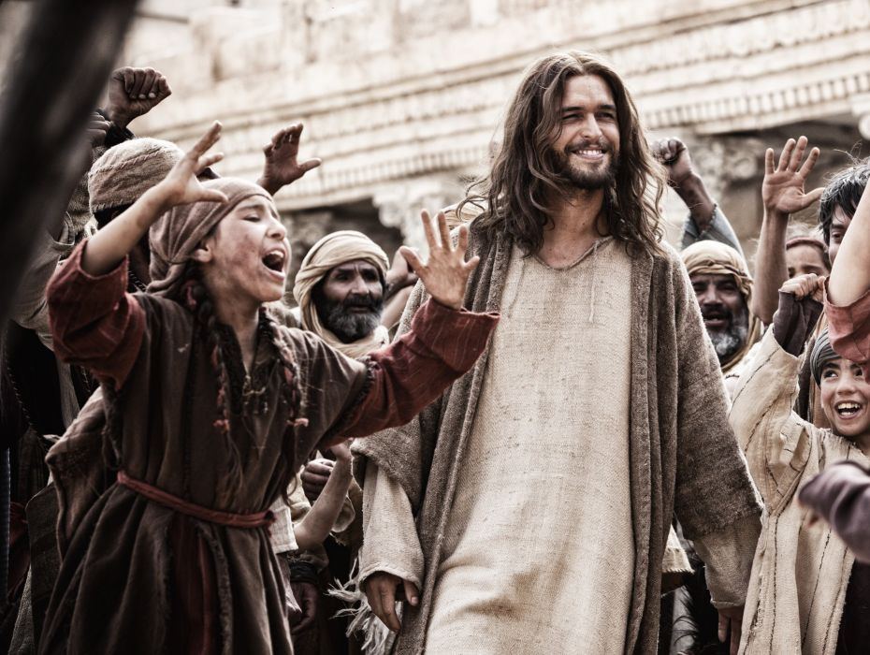
Jesus endorsed the practice of tithing (Matt 23:23) and tithing responds to a law older than the law of Moses. It responds to the law of gratitude.

Slide 4
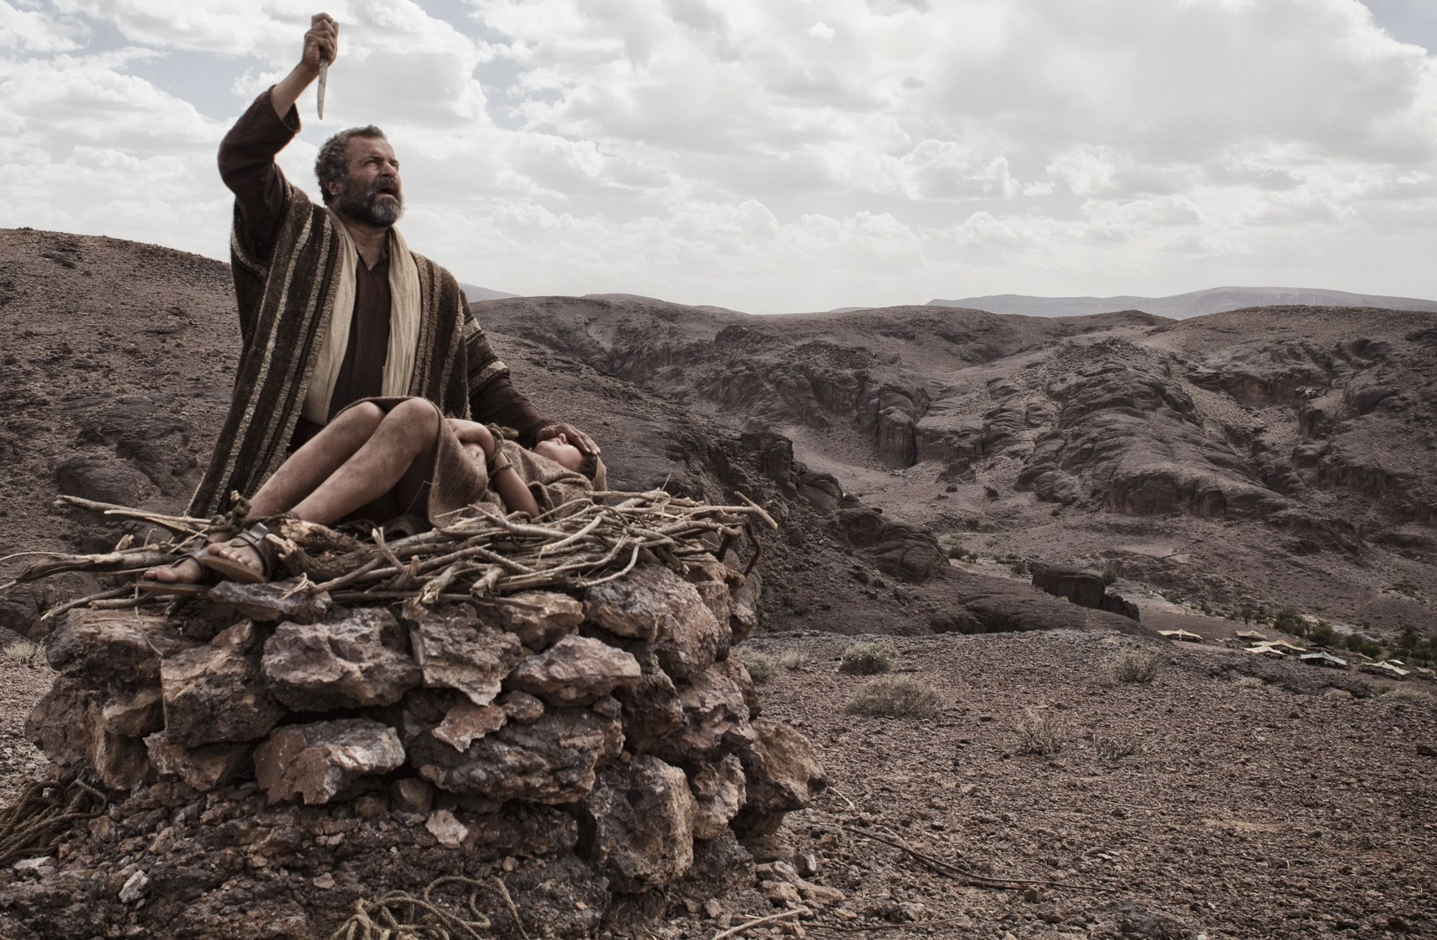
Abraham is the first tither mentioned in the Bible. With his armed servants, Abraham defeated a pagan army led by four kings. Returning with the spoils of war, Abraham encountered Melchizedek, the king of Salem and priest of God.

Slide 5
This king-priest blessed Abraham and blessed the God who had given him victory. In response, Abraham gave him a tenth of everything (Gen 14:18-20).

Slide 6
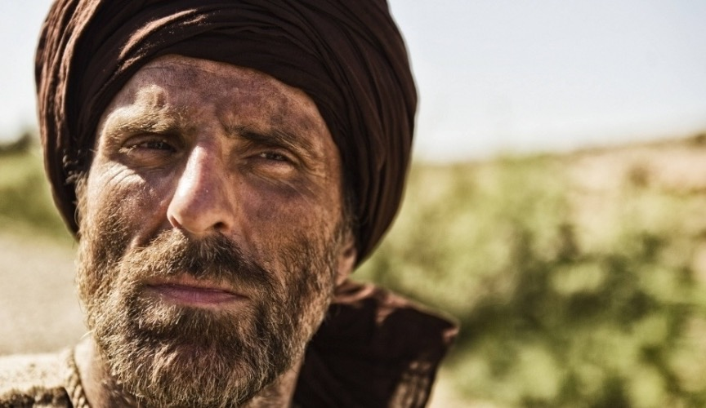
Jacob, grandson of Abraham. Jacob is another tither. He was fleeing through desert country when the Lord appeared to him, promising to be with him, to watch over him, and to bring him back home safely.

Slide 7
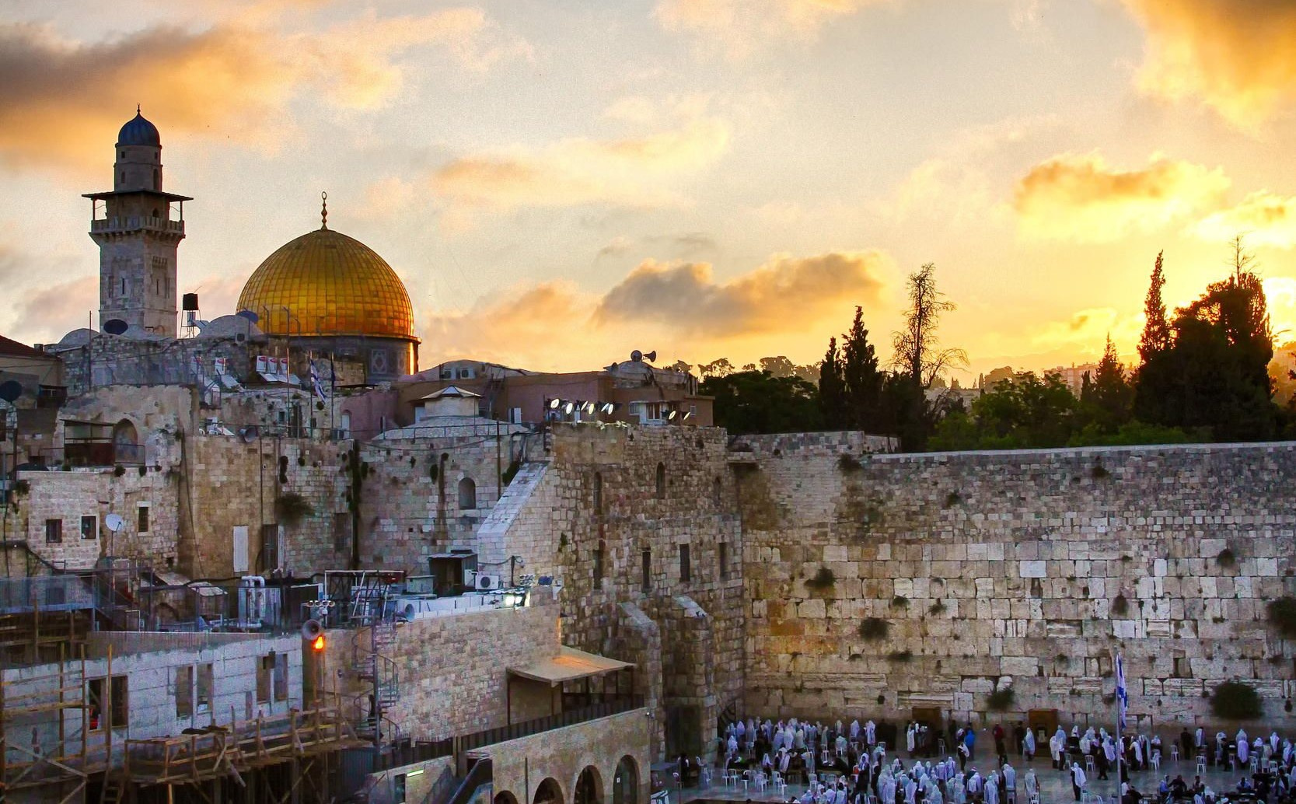
In gratitude for the promised blessings Jacob vowed, Of all that you give me I will give you a tenth (Gen. 28:10-22). Jacob’s offspring became the nation of Israel, a nation formed by God.

Slide 8
When God delivered Israel from slavery, He made a covenant with them and brought them into the promised land of Canaan. The people of Israel were to be governed by laws given by God through Moses.

Slide 9
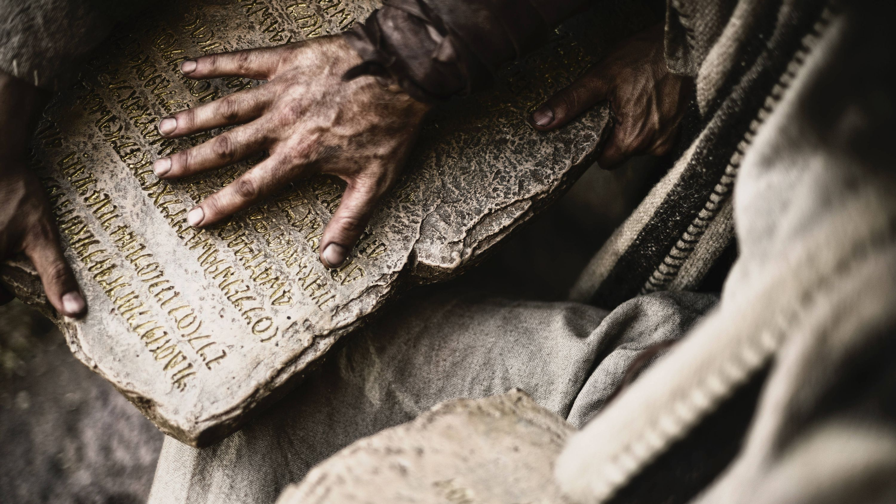
The Law of Moses, as it came to be called, included tithing the produce of the land, the flocks and herds, or the money when crops and animals had been converted to cash.

Slide 10
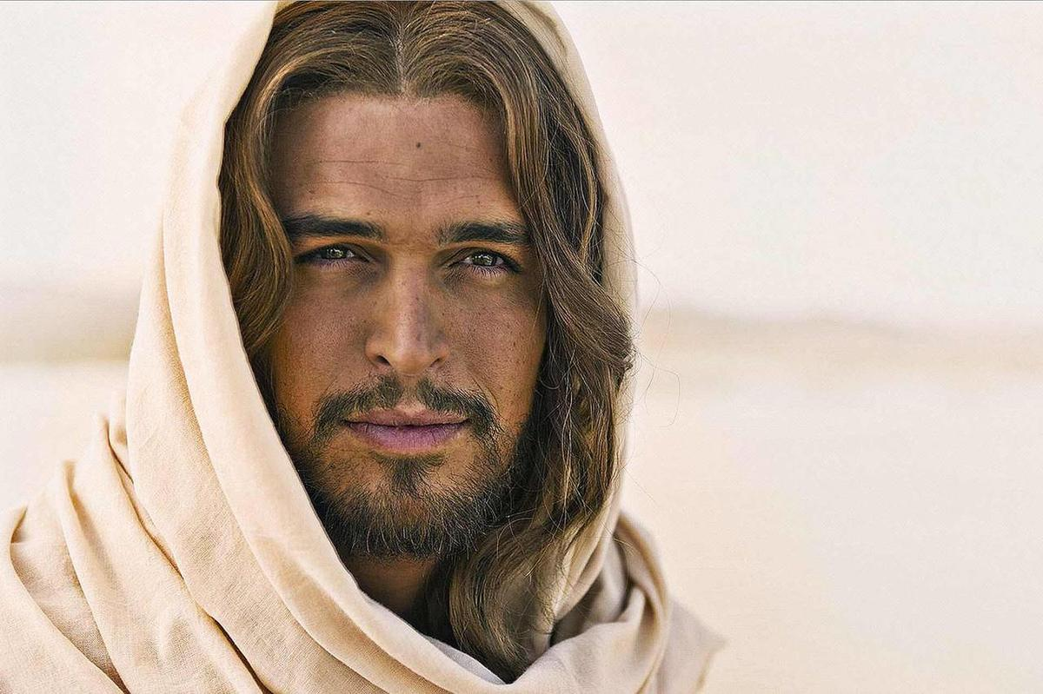
The law declared that a tithe of everything . . . belongs to the Lord (Lev. 27:30). It didn’t become His when it was given; it was already His.

Slide 11
Not to tithe, therefore, was to rob God.

Slide 12
Restoring the ancient practice, in contrast, would bring prosperity to the nation (Mal. 3:8-12).

Slide 13
The tithe is not a means of bribing God to secure a blessing. Rather, the tithe is a way of acknowledging God as the giver of every blessing received and promised.

Slide 14
When Abraham tithed to Melchizedek, it was not to obtain a blessing. He was already blessed and was properly thankful.

Slide 15
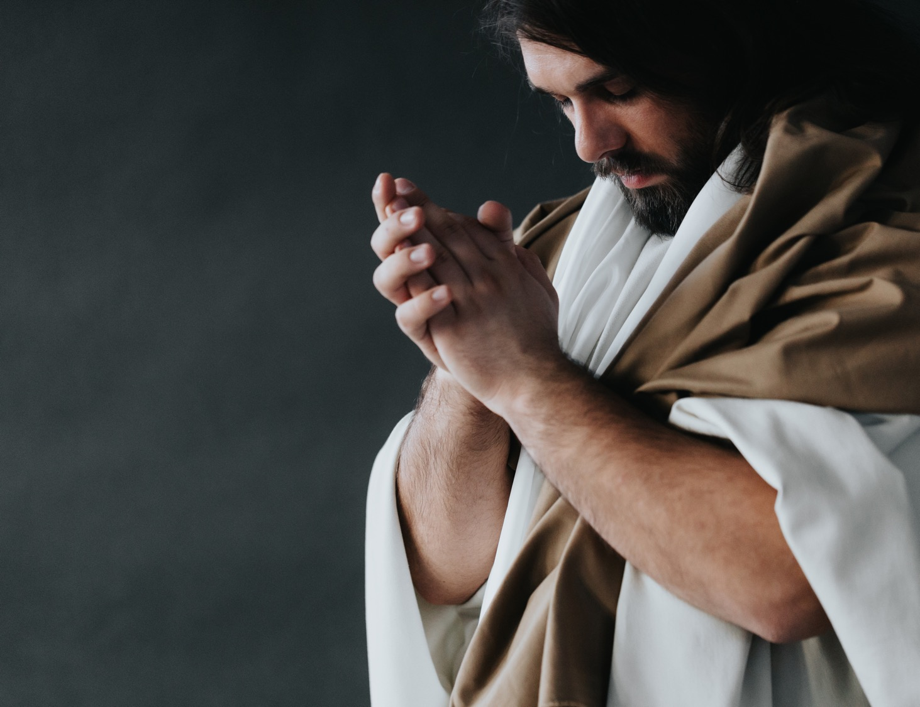
Jesus is our King-Priest, a high priest forever, in the order of Melchizedek (Heb. 6:20). That certainly makes Him a tithe-receiving priest.

Slide 16
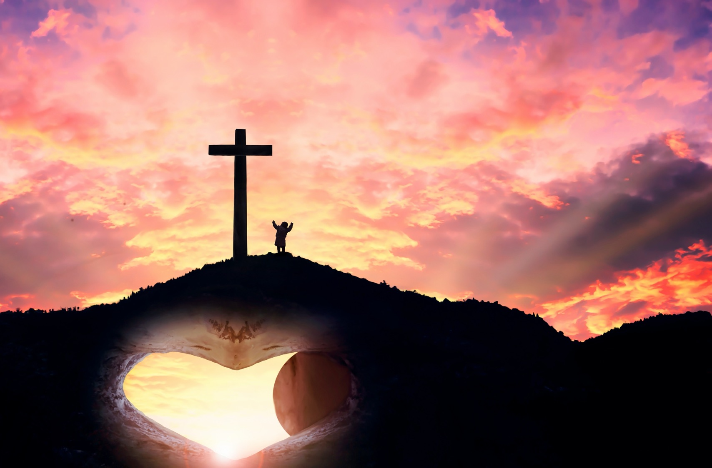
He has blessed His people with the greatest of blessings—their salvation. This blessing was purchased at the greatest of costs—His death. Our gratitude for that should make us joyful tithers to Him.

Slide 17
Israel’s tithes supported the temple and priesthood. Our tithes support the church and its ministry.

Slide 18
Tithing makes it possible for preachers to occupy their pulpits and pursue their rounds of varied services. Tithing makes it possible for missionaries to make disciples among all the nations of earth.

Slide 19
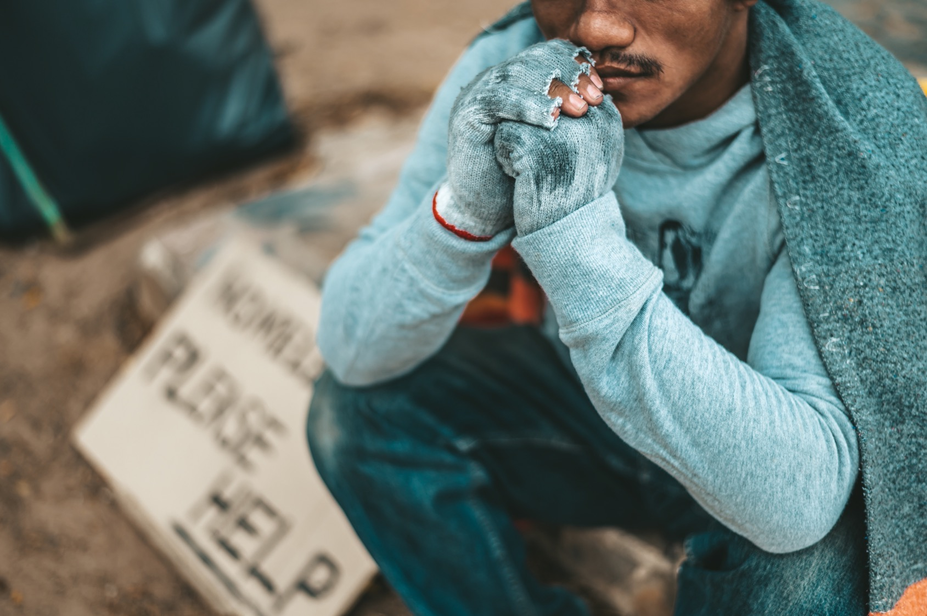
Tithing underwrites the mission of the church to feed the hungry, shelter the homeless, care for the sick, and evangelize the lost.

Slide 20
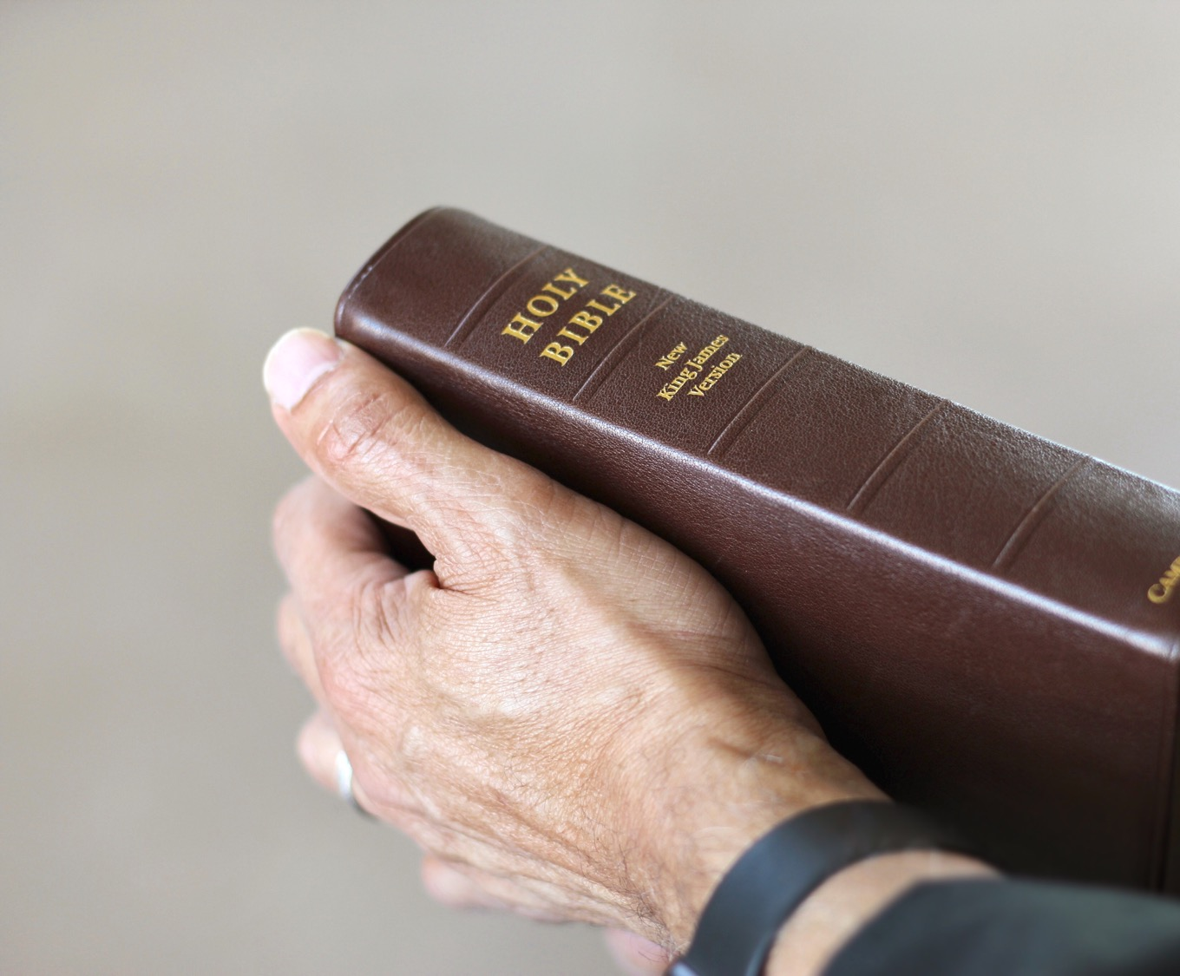
Tithing was not invented by some church finance committee. Tithing is God’s financial plan, and it cannot be improved upon.

Slide 21
It is His basic plan, and devoted Christians gladly add freewill offerings to their tithes. Those who do so are the happiest of the Lord’s followers.

Slide 22
Tithing initiates nothing. It places no claim upon God. It is not a bargaining chip.

Slide 23
Biblically understood and practiced, tithing is human response to divine grace.

Slide 24
We give to God because He has already given to us. He is no poorer if we fail to tithe, but we are impoverished.

Slide 25
He is no richer if we do tithe, but we are enriched.

Slide 26
Tithing is rewarded, for God rewards all obedience to His Word. But we do not give in order to get; we give because we have received.

Slide 27
Tithing:
A Response
to Grace

