Slide 1
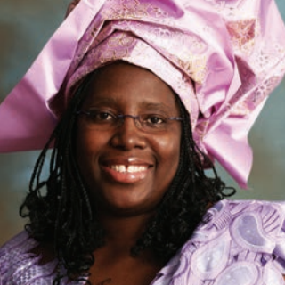
H
WHAT IS IN YOUR
AND
A STEWARDSHIP MINISTRIES DEVOTIONAL
JOHNETTA B. FLOMO

Slide 2
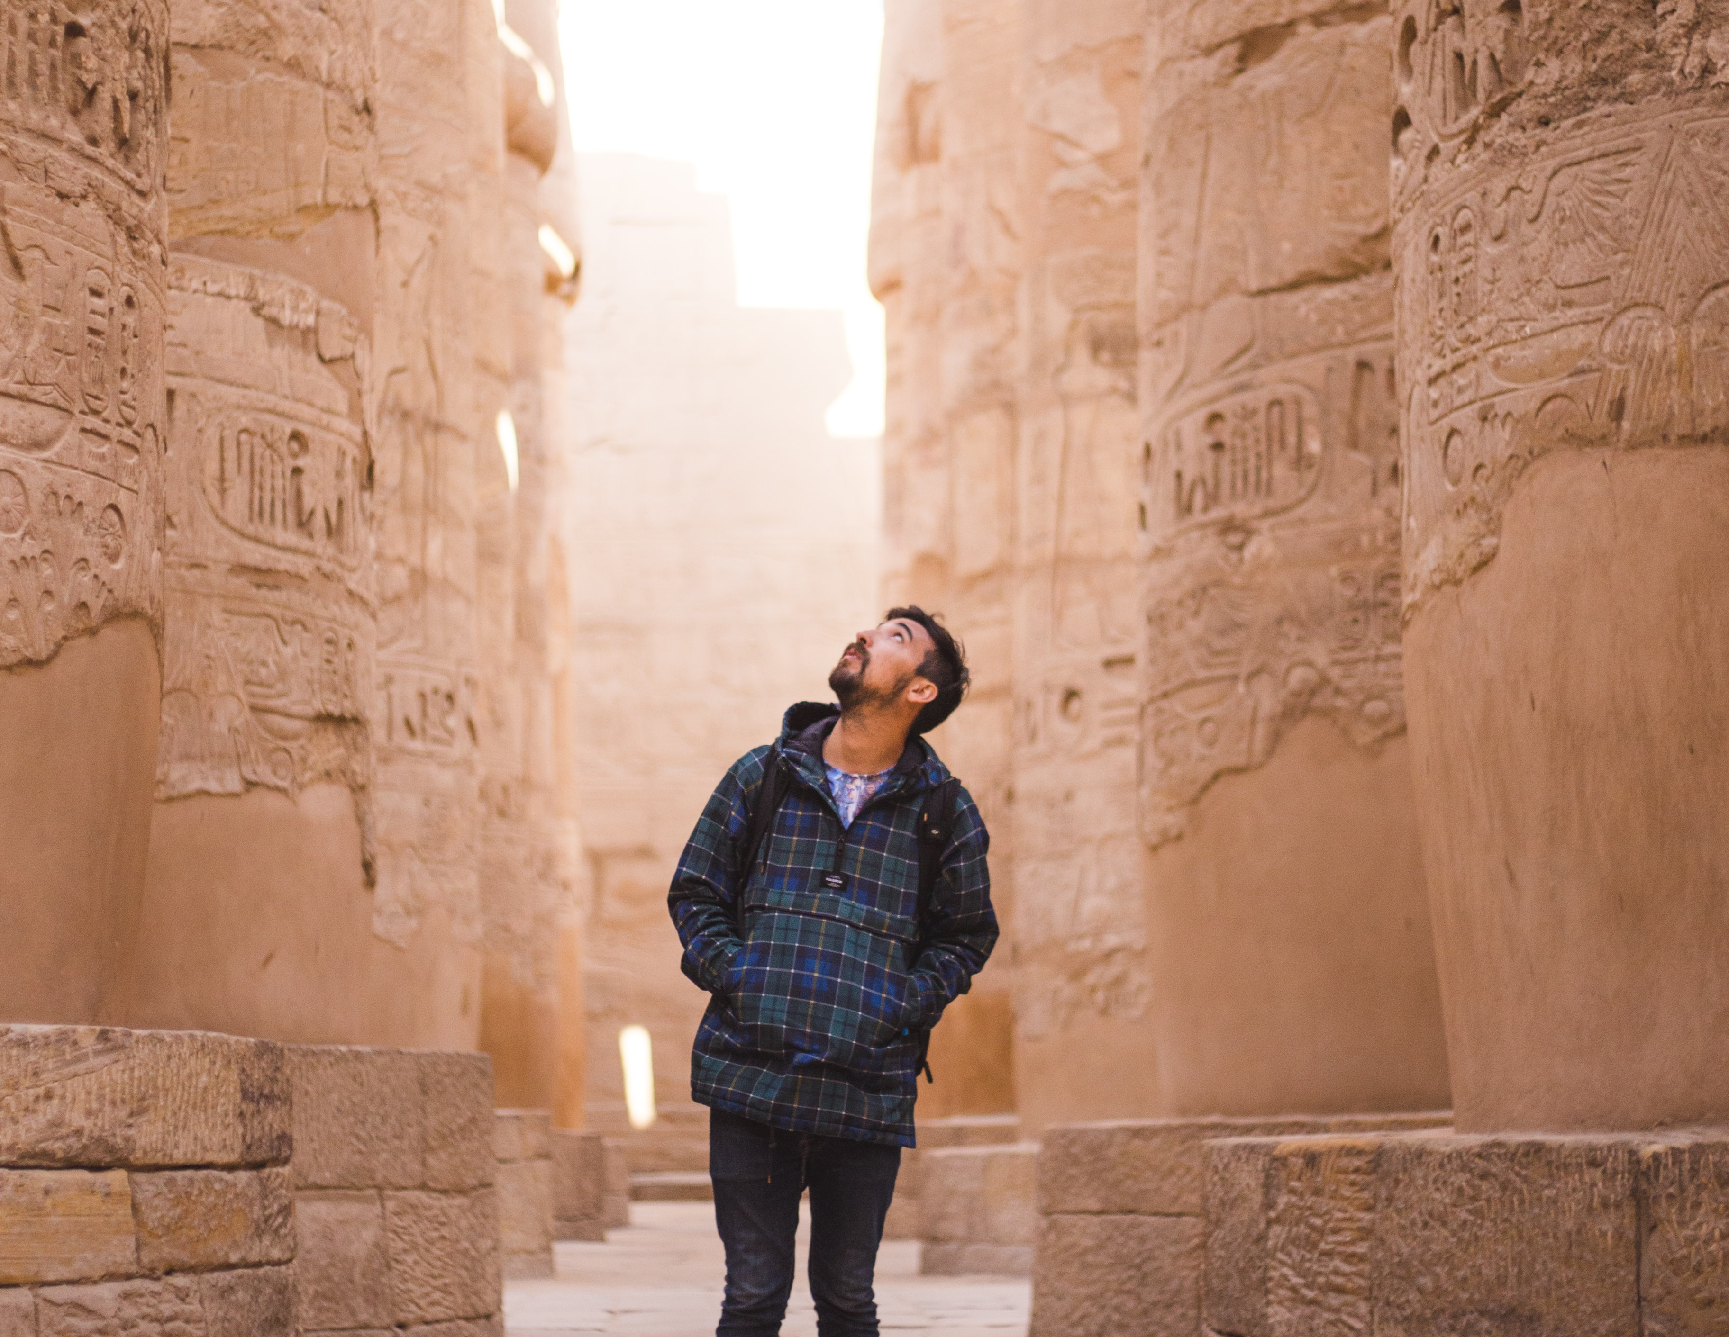
Summary: Allowing God to use what’s in your hand for His glory will not only bless you but bless others as well. A closed hand never receives.

Slide 3
Moses struggles with an identification crisis after discovering that he’s a Hebrew pulled from a basket out of the Nile River.

Slide 4
Would he renounce the royal throne? Or go back to his Hebrew family? Will he have leave the palace to live as a slave?

Slide 5
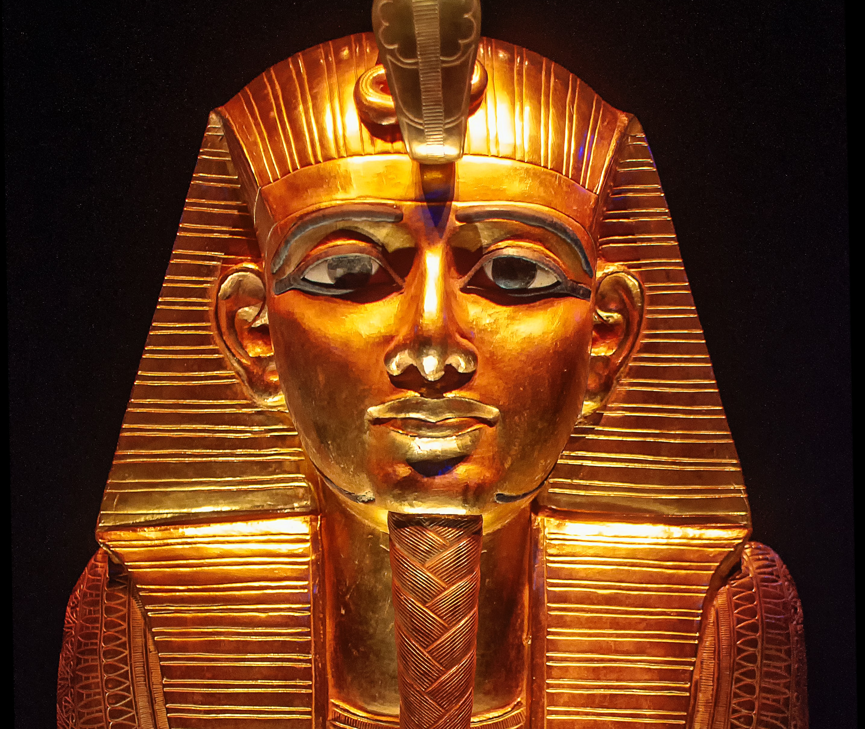
Moses kills an Egyptian slave master and flees to the desert. In one day, he transitioned from being a prince to a wanted fugitive.

Slide 6
Then the Lord appeared to Moses and spoke to him from a burning bush (Ex. 3:7-10) telling him that He cares about the suffering of His people and wants Moses to deliver them; but Moses focused on his flaws.

Slide 7
Four times, Moses gives God excuses: “Who am I for such a task?” “How can I convince them?” “Nobody will believe me!” “Please, send somebody else.” (Ex. 3:11, 13; 4:1, 10)

Slide 8
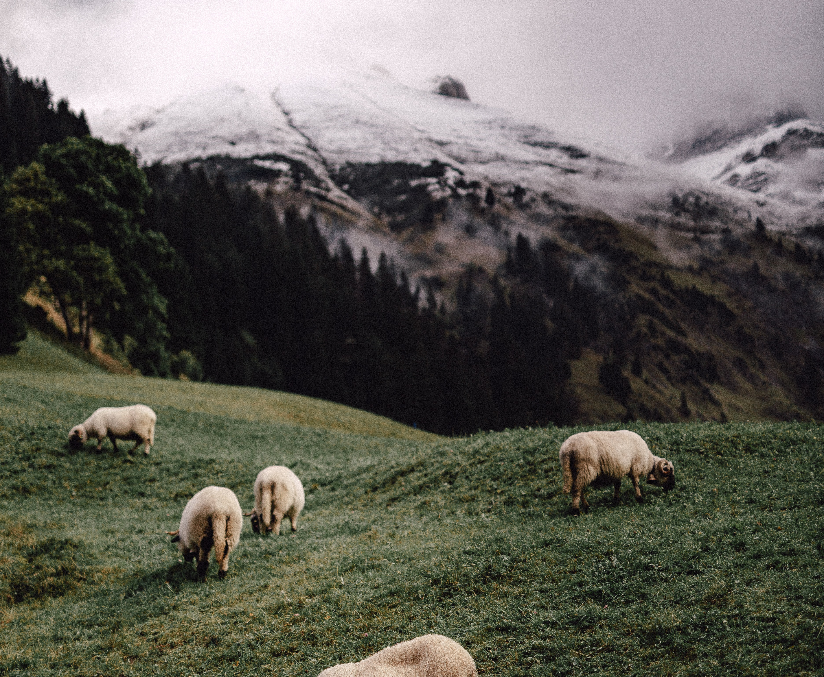
“What is in your hand?”
the Lord asked.
“A shepherd’s rod,” Moses replied.
"Throw it down,” said the Lord.
“Throw it down?” (Ex. 4:2, 3).

Slide 9
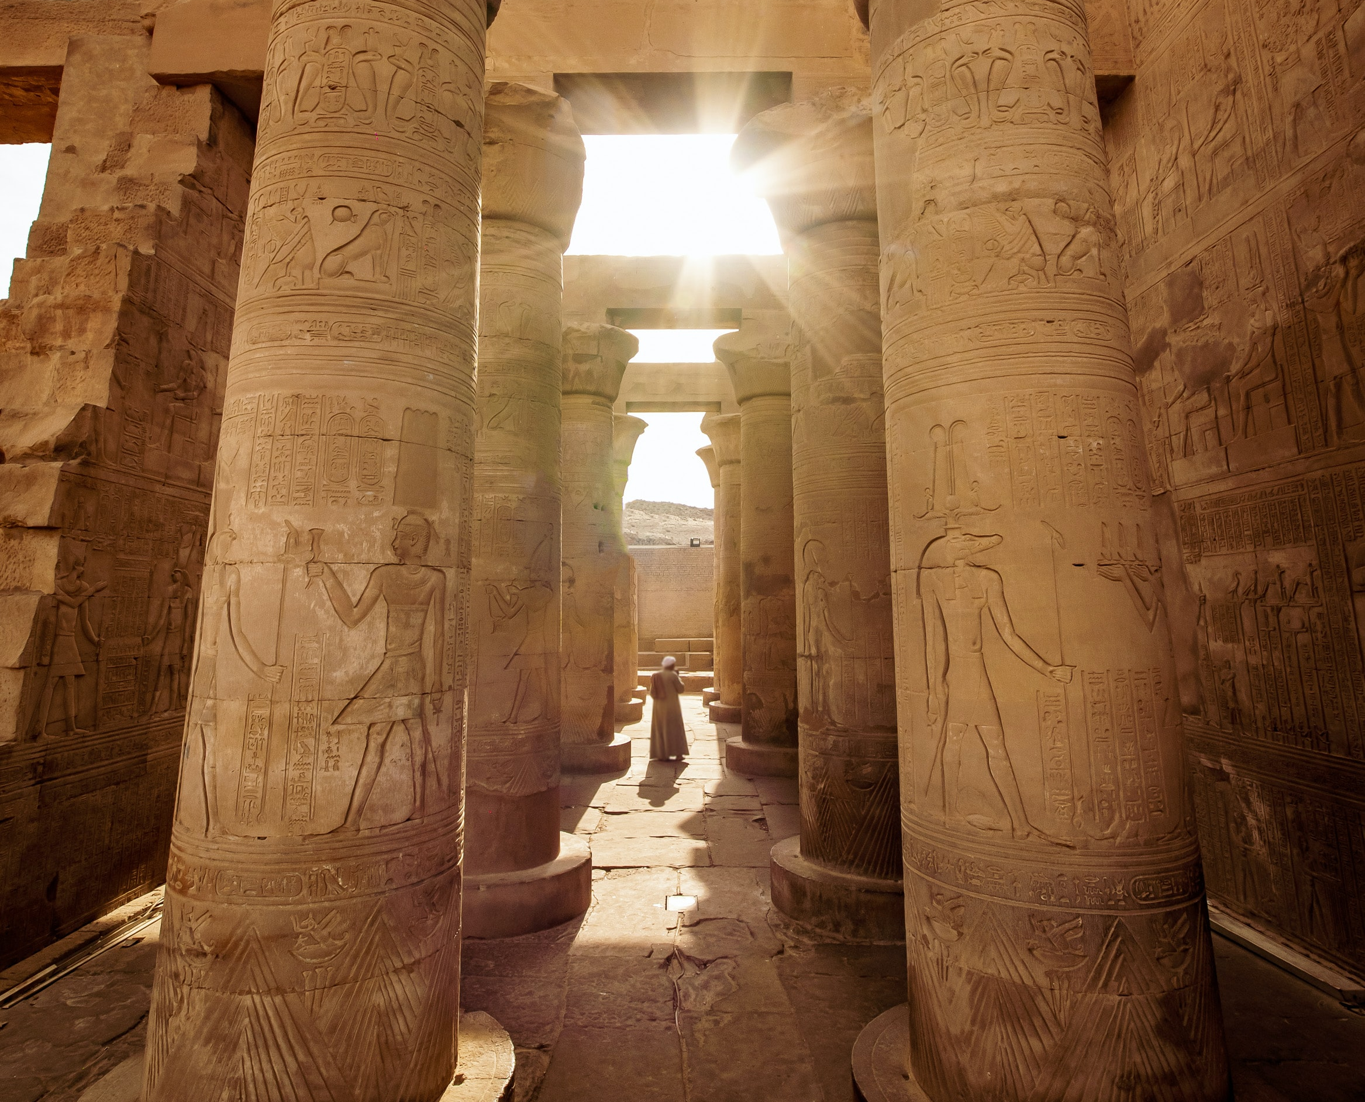
Once a prince holding a scepter, now a shepherd holding a shepherd’s rod. The staff represented five important things in Moses’ life. Given to God, He would use it to perform miracles.

Slide 10
The staff represented Moses’:
Identity—a shepherd;
Income—working for father-in-law;
Protection;
Status in Society;
But it blocked him from living out his full Potential.

Slide 11
Moses could not become the man God wanted him to be until he agreed to throw down the staff, his prized possession, and trust God.

Slide 12
Are you clinging onto things that hinder your potential? Is it your past, pain, or sorrow. Could it be your hurt, disappointment, or things people have done or said to us. Or unforgiveness?

Slide 13
If we would like the Lord to change the course of our lives and mold us, we must release what’s in our hands.

Slide 14
We may never meet God in a burning bush or free a nation from slavery, but He is calling us to drop what’s in our hands and allow Him to shape us for His service.

Slide 15
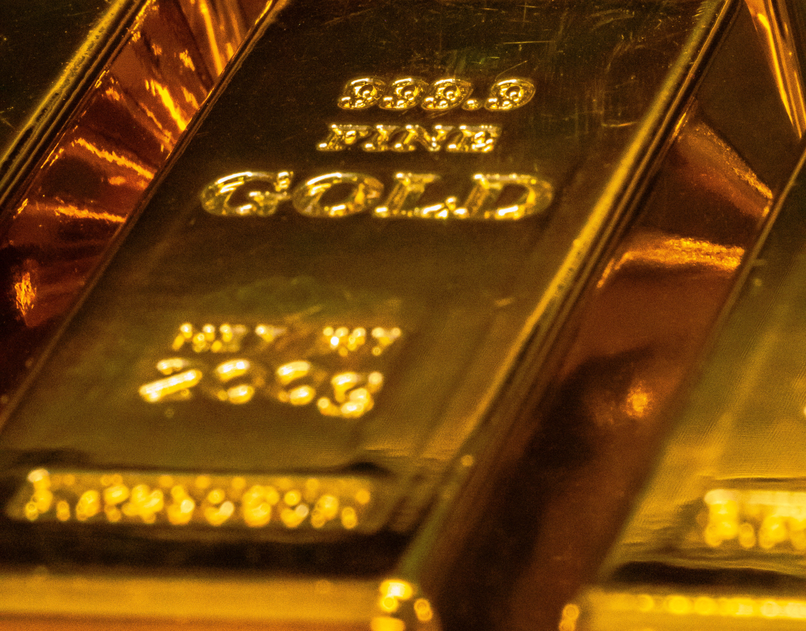
What did they have in their hand?
Jochebed —straws
Abraham—heir, only son
Hannah—first son
David—five stones, a sling
Ruth—stalk of grains
Widow of Zarepeth—flour and Oil
Little Boy—five loaves of bread and two fishes

Slide 16
Unfortunately, some find it hard to let go of all they possess. Returning only a portion of their income to God often seems difficult. It is easy to focus on our needs and neglect to trust God.

Slide 17
Don’t be like Ivan the Great, a fifteenth-century Russian Czar, who was encouraged to marry the daughter of the king of Greece. Ivan accepted to be baptized as a “Greek Orthodox”.

Slide 18
On the day of the ceremony, Ivan and his soldiers stood, in full armor, in the waters of the Mediterranean Sea, ready for baptism. They couldn’t have two identities—warriors and Greek Orthodox.

Slide 19
Right before their baptism, they agreed to keep just their sword arm above the water! The ceremony was nicknamed “the unbaptized arm.”

Slide 20
Jesus made it clear, “No man can serve two masters” (Matt. 6:24, KJV). Do you have an unbaptized arm? Have you totally surrendered your all to God?

Slide 21
WHAT IS IN
YOUR HAND?

